Slide 1
Smart Battery Charger
For you and for the world
Team members:
Anna Geraci s296018
Carlo Simone s297278
Fabio Gianino s301556
Michele Claudio Petrocelli s305945

Slide 2
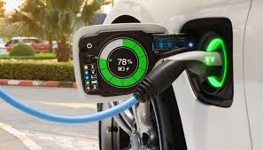


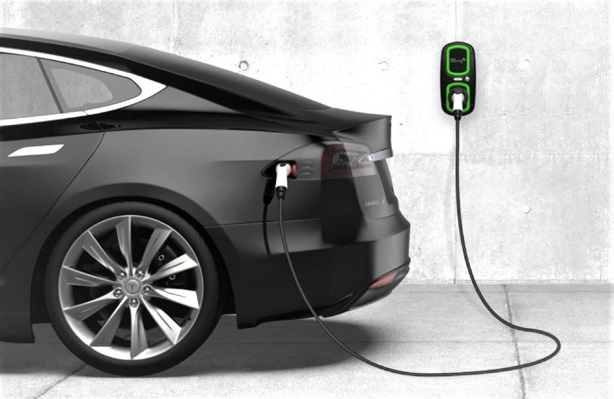




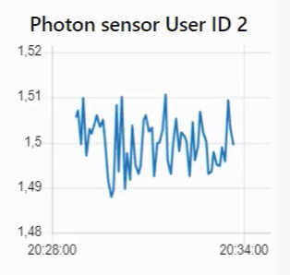
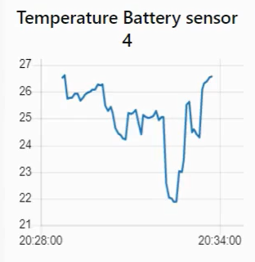


Smart Battery Charger
Battery Percentage Available
Send Alert SMS
Temperature Sensors
ON/OFF
Photon Sensors
Charge or not?
User Agenda
User Request
Collect statistics

Slide 3


General information about Smart Battery Charger application
Main characteristics:
- remote control of appliances.
- control strategies to minimise energy cost.
- end-user application for energy-awareness.
- end-user application for battery autonomy.
- unified interfaces (i.e. REST Web Services and MQTT queues) available to enable Demand/Response.
Stakeholders:
Smart Automotive, Smart grid, Smart Building

Slide 4
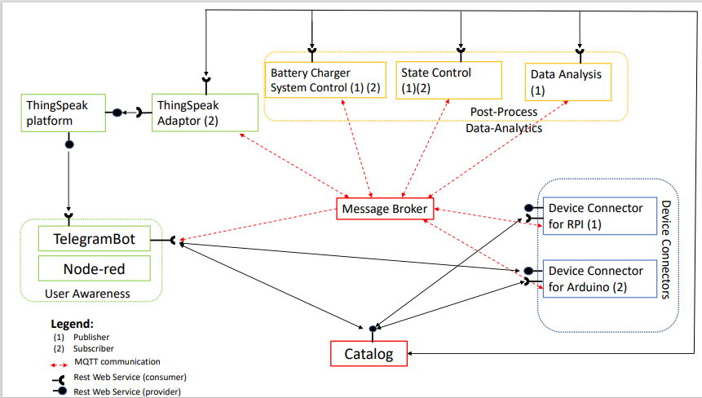
Use Case Diagram - Proposal

Slide 5
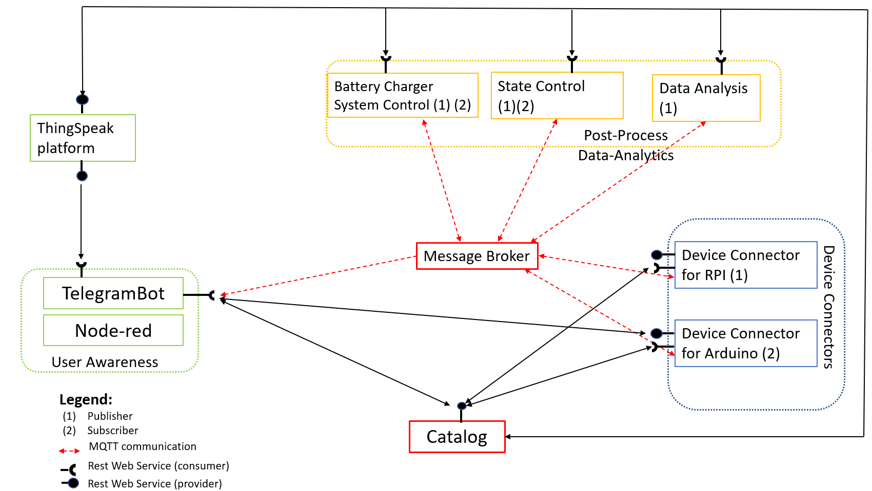
Use Case Diagram - Update

Slide 6
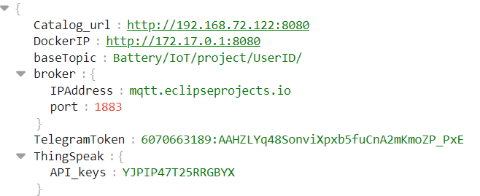
Catalog
The Catalog.json contain all the information about:
General Configuration:
Contain information common to the whole application:
IP address of the Catalog, indeed it communicates with the other component with REST.
Information for the MQTT communication exploit by the sensors: base topic, IP and port of the broker.
Telegram token of the bot.
API keys of ThingSpeak.
This part is contained also in the file settings.json common to all the actor.

Slide 7
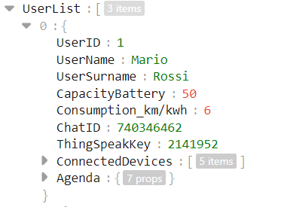
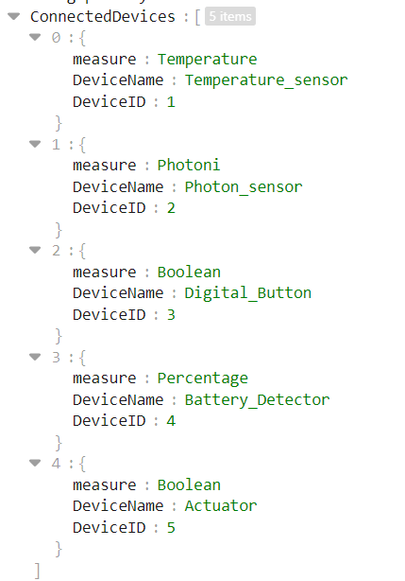
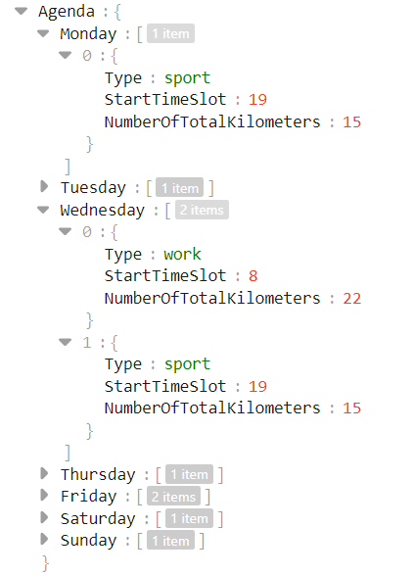
Catalog USER list
User List:
Contain information about all the USER, each USER has:
UserID associated.
Capacity and consumption of the USER’s battery, specific for each battery.
ChatID of Telegram, to associate the Telegram profile of the USER to the Bot of the application.
ThingSpeak channel ID, associated to the USER.
List of connected devices.
Agenda of the USR.

Slide 8
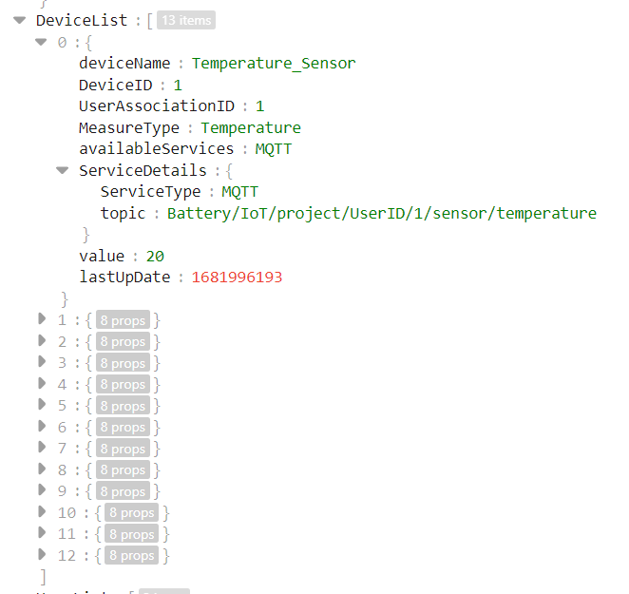
Catalog DEVICE list
Device List:
Contain information about all the Devices that the application should manage:
Device ID associated to the sensor.
USER ID of the USER associated with this device.
Communication paradigm used by the sensor and in case of MQTT the topic associated with its.
Value sampled from the sensor.
Timestamp correspondent to the last time in which the sensor sampled something

Slide 9
GET method
IP/AllUsers
It communicates with all the other actors in the platform exploiting REST communication.
GET: Retrieve information
PUT: Update information
POST: Add information
IP/UserID/1
IP/catalog
IP/MessageBroker
GET
IP/TelegramToken
IP/AllDevices
IP/DeviceID/12
IP/Agenda/*userID*

Slide 10
PUT method
It communicates with all the other actors in the platform exploiting REST communication.
GET: Retrieve information
PUT: Update information
POST: Add information
IP/Device
lastUpdate
Methods used by sensors
IP/Actuator
value
PUT
IP/User
Battery info
Methods used by user only through PostMan
IP/AgendaUpdate
IP/AgendaRemove

Slide 11
POST method
It communicates with all the other actors in the platform exploiting REST communication.
GET: Retrieve information
PUT: Update information
POST: Add information
IP/Device
Method used by the user only through postman
IP/User
POST
IP/ChatID
Method that could be used through Telegram Bot
IP/Agenda

Slide 12
Update the DeviceList
Each sensor sample with a period of 5 seconds and through:
The PUT method Update the Device List with the value sampled and the timestamp.
The POST publish the json with all the useful information about it. The application check if it is already present in the list or not through thte Device ID.
The catalog.json file has a logic of maintenance that remove all the device that has a ‘lastUpdate’ section with a timestamp older than 120 seconds.
If a sensor does not work for more than 120 seconds, was deleted from the Device List because it was useless, to the objective of the application.

Slide 13
Device Connectors: sensors
Each sensor uses:
REST: to communicate with the server and update the catalog at each new occurrence of a measurement
MQTT: to transmit the values detected to the actors that use them (control strategy, ThingSpeak)
In order to do this, some different Python classes are used.

Slide 14
Sensors taxonomy
MEASURED QUANTITY | MEASUREMENT UNIT | SIMULATED | MQTT topic (after …/sensor) | Usage
Temperature | Celsius degrees (°C) | Yes or no | /temperature (environment) /temperatureB (battery) | Air conditioning control (environment T sensor) Battery charger control (battery T sensor)
Presence | Adimensional (binary) | Yes | /presence | Presence of the car in the garage (battery charger control)
Battery percentage | Percent (%) | Yes | /battery | Battery charger control
Light (photons) | Volts (V)* | Yes | /photon | Checks whether the sunlight radiation is sufficient to allow low-cost battery charging in non-urgent situations
Switch state | Adimensional (binary) | Yes | This is not really a sensor, it only acts as one for some aspects | Checks whether manual charge switch is on or off (relevant when actuator state flag == 2)

Slide 15
Device connector: «Sensors» classes
The various individual sensor classes all inherit most of their basic structure from a parent Sensor class (hierarchical inheritance).
High level of intercompatibility
No need for higher level customization
Most sensor classes generate values using instances of appropriate «simulator» classes.
Possibility to implement physical sensors as well
Built-in timeout error check
Generation of SenML-compliant outputs
Sensor
PresenceSensor
PhotonSensor
TemperatureSensor
others

Slide 16
«Sensors» classes: common features
Attributes
Device ID
User Association ID
MQTT topic
Connection and last update times
Measured quantity and value
SenML compliant dictionary
Methods
Value and time update
Error check
Sensor
PresenceSensor
PhotonSensor
TemperatureSensor
others

Slide 17
Device connector: CatalogUpdater
The CatalogUpdater class performs all the operations involving the sensors’ entries in the device catalog using REST-compliant requests handled by CatalogServer
Presence check (GET request)
Primary key: device ID (must be unique for each device in the whole system)
Sensor insertion (POST request)
Sensor update (PUT request)
Server
CatalogServer
(1)
Request
(2)
Response
CatalogUpdater
Device

Slide 18
Sensors overview
SensorPublisher
REST request
CatalogUpdater
CatalogServer
REST response
DeviceID
SenML messages
MQTT topic
Server
MQTT publish
Message broker
Sensor
Device

Slide 19
Device connector: SensorPublisher
Initializes MQTT client
Includes an instance of CatalogUpdater
Deals with MQTT (directly) and REST (via CatalogUpdater methods) transmissions
MQTT: publishes sensor updates
REST: keeps catalog up-to-date

Slide 20
Device connector: actuator overview
Battery_charger_
state_control
MQTT
publish
Message broker
Actuator
MQTT subscribe
MQTT
onMsgRec
Control signal
Feedback signal
ArduinoPiConnector
Serial
Arduino
REST
request
CatalogServer
CatalogUpdater
REST
response
ActuatorSubscriber
Server
Raspberry Pi

Slide 21
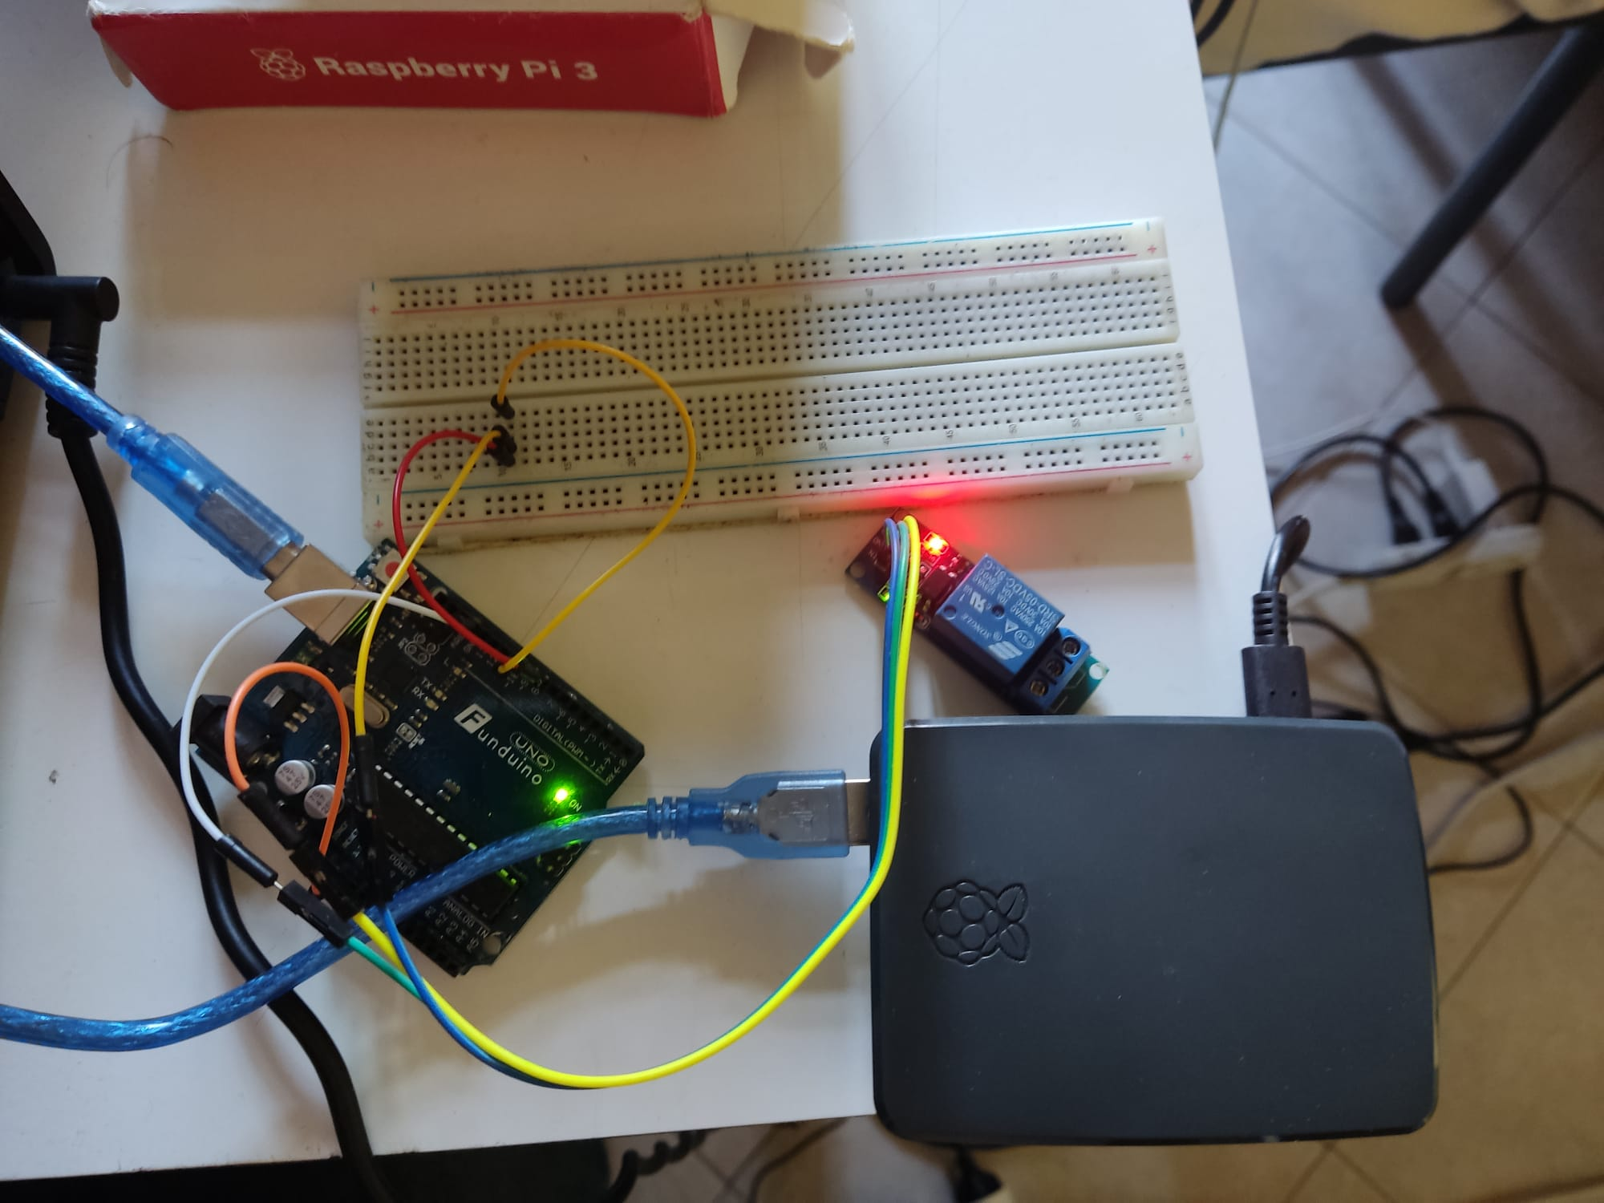
Actuator: ActuatorSubscriber and Arduino Connector
Subscribes to MQTT actuator topic
Includes instances of:
CatalogUpdater: updates catalog
ArduinoPiConnector: manages communication with Arduino
Uses PyFirmata library
Serial communication via USB port of Raspberry Pi
Arduino converts serial PyFirmata instructions into actual electrical signals for actuator and receives coherence feedback

Slide 22
1. Battery Charger System Control
Communication with:
Sensors: Retrieves data from sensors and process them. (MQTT)
Actuator: Sends command to the actuator (On/Off). (MQTT)
User: Retrieves data about what the user want through User Awareness interface (Node-red and Telegram - ManualFlag). (MQTT)
Catalog: Retrieves data of the user and general data of the application; and publish the value of the actuator computed.(REST)
Control Strategy Agenda: Retrieves the value of the percentage of battery necessary in this day according to the Agenda of the user. (MQTT)
Main role:
Retrieve data and choose if the car must be in charge or not according to the logic reported on the right.

Slide 23
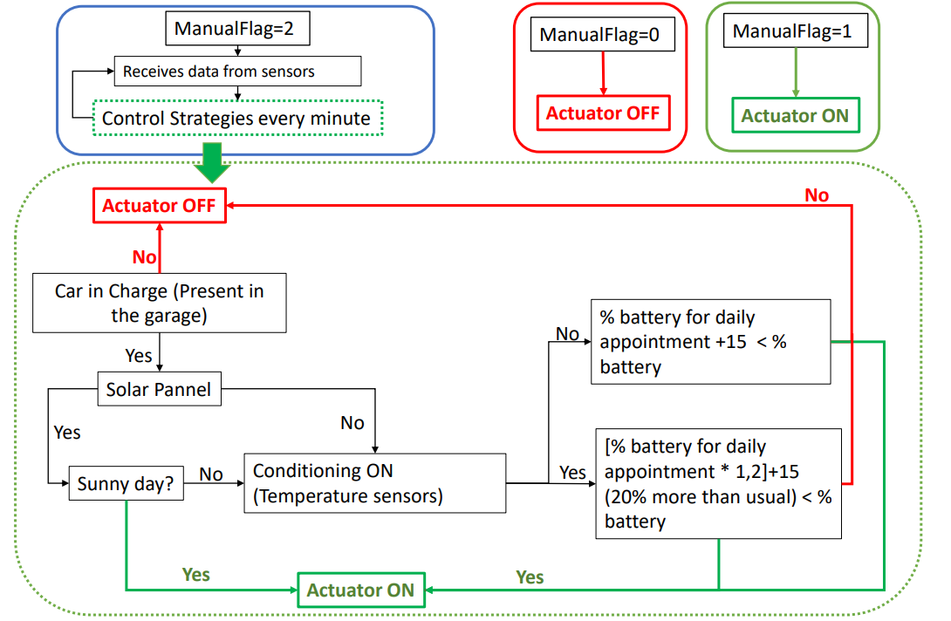

Slide 24
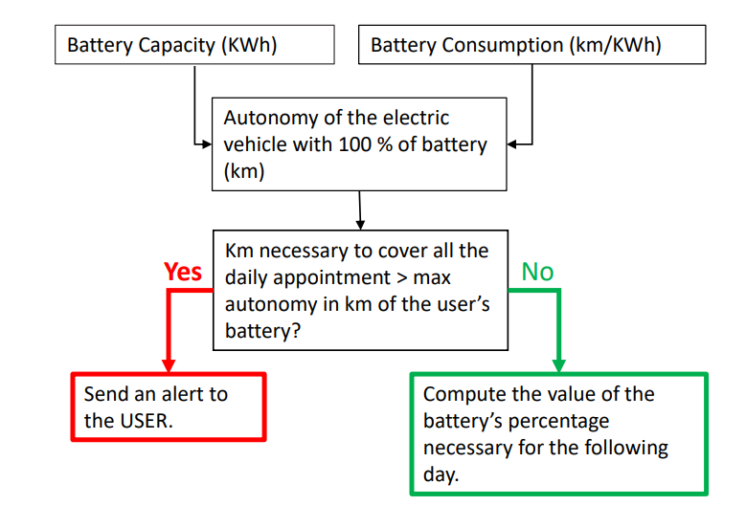
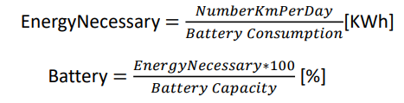
Agenda Control Strategy Compute the percentage of battery necessary to the specific user each day, according to the Agenda information.
Communication with:
Catalog: to retrieve information about user’s battery characteristics and user’s Agenda. (REST)
StateControl: to send AlertSMS, in case it may be necessary. (MQTT)
Actuator Control Strategy: to send information about the percentage of battery needed by the user in this specific day. (MQTT)
Main role:
Compute the percentage of battery necessary for the users during this day, according to the battery characteristics and the personal commitments.

Slide 25
2. State Control
Communication with:
Sensors: to retrieve information about the status of the battery and general information. (MQTT)
TelegramBot: to send AlertSMS, in case it may be necessary. (MQTT)
Agenda Control Strategy: to retrieve information in case the number of kilometers is too high for a single recharge cycle. (MQTT)
Catalog: To retrieve information about sensors end-point and user (REST)
Main role:
Send Alert SMS to the user, about the status of the battery.
Vehicle present in charge station
Temperature of the battery.
Percentage of battery too low
Km necessary more than autonomy

Slide 26
3. Data Analysis
What is it?
Data Analysis is the block which manages all the energy data provided by the energy sensors. These information regards:
The percentage of the car battery;
Battery temperature;
Photons.
Communication with
Catalog Server: using REST-full communication protocol, in order to retrieve informations about Users and IoT devices;
Sensors: using the MQTT communication protocol, in order to retrieve data;
ThingSpeak Adapter: using REST-full communication protocol, in order to provide the measurements.

Slide 27
Data Analysis
How does it get these data?
It uses the MQTT communication protocol
Temperature sensor
Message (topic 1)
Message Broker
Data Analysis
Photon sensor
Message (topic 2)
Subscribed to all topics
Message (topic 3)
Battery detector

Slide 28
Data Analysis
How it works?
After subscribing to the topic, it retrives, manages and collects the data in a block containing all the informations of each sensor, for all users. This block contains:
UserID : It lets to know which user the sensor is associated with;
DeviceID: it lets to know which is the considered sensor;
Topic : where the messages related to that sensor are published;
Value : where the data is stored;
Channel : it contains the API-Key related to the user ThingSpeak channel;
Field : it explains exactly in which thingspeak graph it will have to be recorded.

Slide 29
ThingSpeak
What is it?
It is a platform which allows you to collect data streams in the cloud from IoT devices, so it is like a database.
Allows you to implement communication via MQTT or REST-full. In our case, via REST-full;
Increases both the scalability of the platform and the interoperability between the components.
Communication with:
Data Analisys: using REST-full communication protocol, in order to retrieve the measurements.
Telegram Bot: to provide the energy graphs.

Slide 30
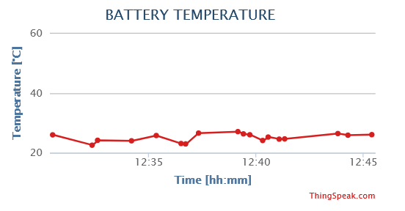
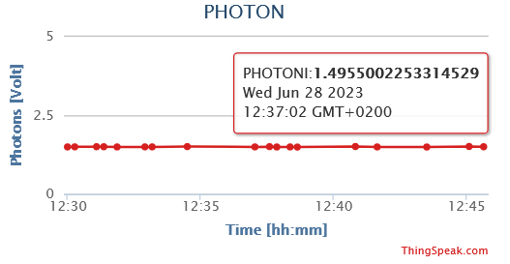
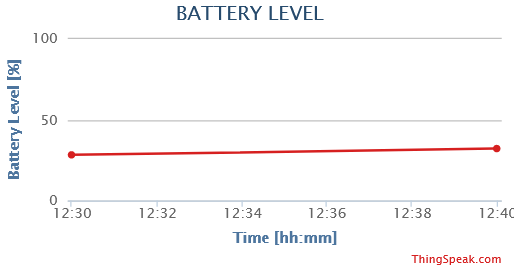
ThingSpeak

Slide 31
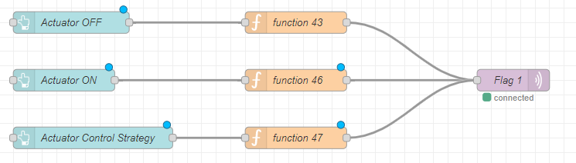
Node-red
Communication via MQTT with:
Sensors: to retrieve the information that they detect.
Actuator Control Strategy: to send information about value of the flag about the manual actuation.
Main Role:
Visualize data come from sensors and allow the user to set the Charger On or Off manually, through 3 buttons that sends MQTT messages to the topic related to the manualFlag.

Slide 32
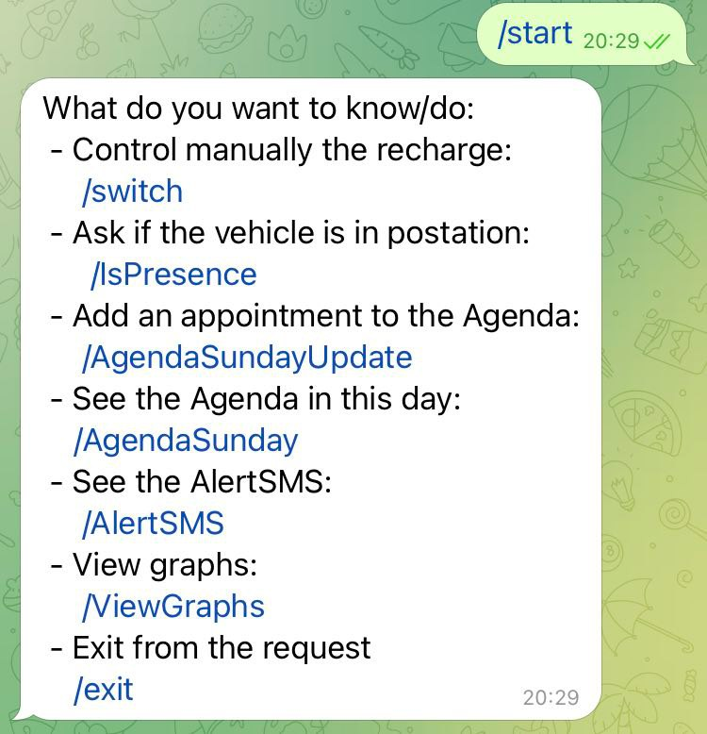
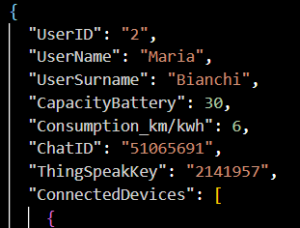
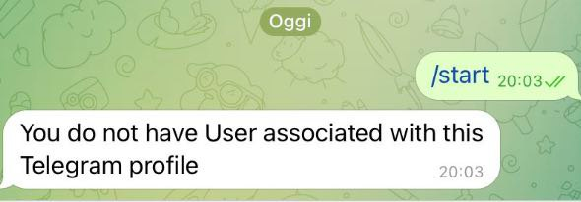
Telegram Bot
Each user registered his Telegram Profile through the ChatID in the Catalog, if your profile is not registered the bot tell you that you do not have the permition.
Command:
/start: Show to the user all the command available on TelegramBot.
/IsPresence: Communicate to the user if the vehicle is in charge station or not.
/AlertSMS: Communicate to the user if there are issue about the charging of his vehicle.
All this commands shows to the user the information that he requests, through text.

Slide 33
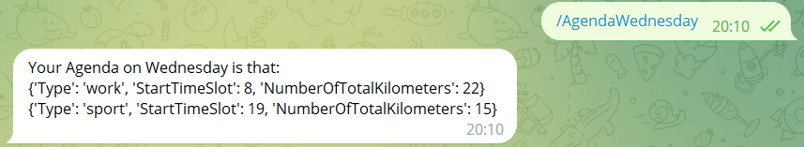
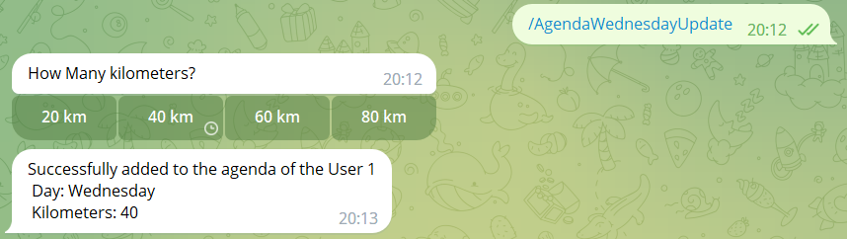
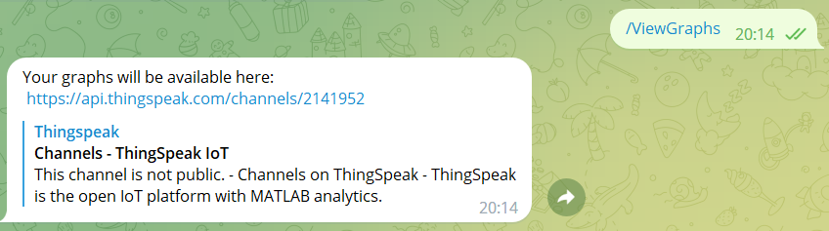
Telegram Bot
/Agenda*day*: Show to the user the Agenda saved in the catalog according with the *day* specified.
/Agenda*day*Update: Allow the user to add to the Agenda a new commitments in this specific *day*
/ViewGraphs: Show to the user all the graph about the sensors and use of the application.

Slide 34
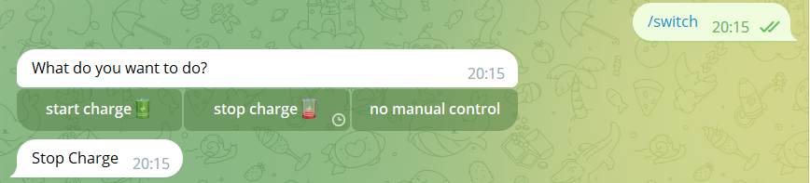
Telegram Bot
/switch: Allow the user to choose the charge status of the car.
/exit: Allow the user to exit from any request
You can continuosly send a charger actuation, until you don’t send another command or send /exit

Slide 35
Thanks for the attention!
Anna Geraci
Fabio Gianino
Carlo Simone
Michele Claudio Petrocelli

